Slide 1


INDISPENSABLE SKILLS

Slide 2

TOPICS
01
PERSUASION
02
NEGOTIATION
03
STANFORD UNIVERSITY STUDENTS

Slide 3
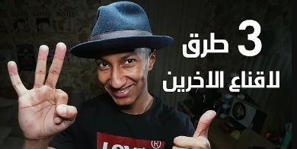
PERSUASION
دوباميكافين Dupamicaffeine

Slide 4





PERSUASION
The worm and the hook
“If you want to catch a fish, put a worm on the hook”
Give him what he wants, not what you want
Look for the need

Slide 5

PERSUASION
Socratic principle
If someone tells you no, it is one of the most difficult obstacles

Slide 6

PERSUASION
Socratic principle
The nervous system is rejecting
The person insists on seeing that he is not wrong

Slide 7

PERSUASION
Socratic principle
The nervous system begins to relax and the person becomes open and satisfied to talk to you
Because your ideas are similar
A skilled speaker is the one who gets the most yeses

Slide 8



PERSUASION
Present your offer in an exciting way
Highlight the gain that accrues to the person
Be empathetic and friendly

Slide 9

A person wants to buy a car and his mother refuses
Use principles of persuasion
The worm and the hook
Socratic principle
Present your offer in an exciting way

Slide 10
NEGOTIATION

Slide 11


NEGOTIATION
KNOW YOUR VALUE WELL
BEFORE ENTERING INTO ANY NEGOTIATION

Slide 12
STANFORD UNIVERSITY STUDENTS

Slide 13


HOW STANFORD UNIVERSITY STUDENTS EARNED 650 EUROS WITH A CAPITAL OF 5 EUROS WITHIN TWO HOURS

Slide 14



WHAT PROBLEM
WE'RE FACING
THEY CONTACTED MORE THAN ONE COMPANY AND OFFERED TO SELL THEM THE 3 MINUTES

Slide 15




HOW DID YOU GET THE 650 EUROS?
THEY OFFERED THE COMPANY'S SERVICES
Summer courses and training

Slide 16


WHAT SKILLS DID STAFFORD UNIVERSITY STUDENTS USE?

Slide 17

THANK YOU

